Slide 1

RPPOOP
Project -
Attendance Management System
112103098 - Rukmini Nazre
112103099 - Omkar Oak

Slide 2
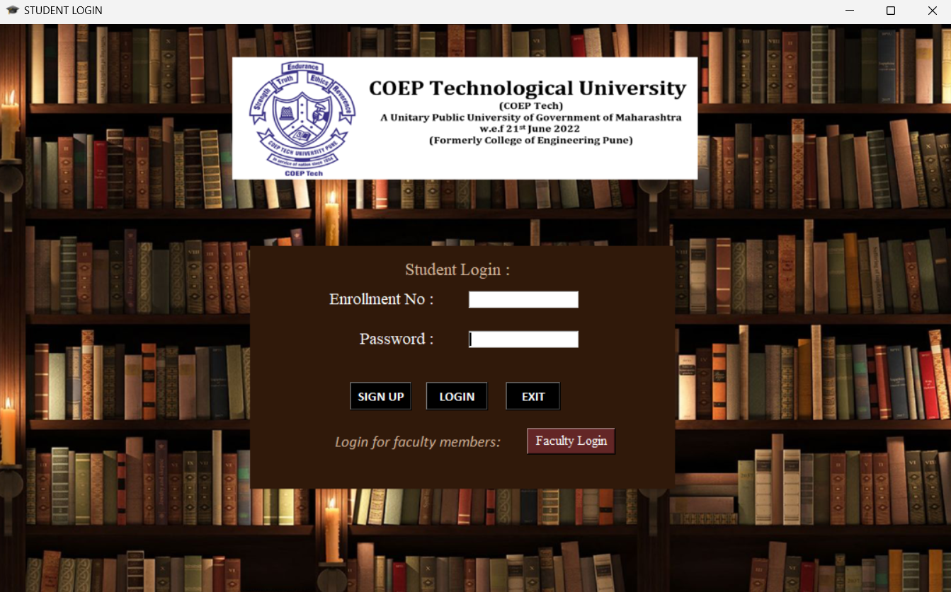
Main Page
This is the main landing page
It connects to the entire System and can be used to go around by students and faculty alike
Consists of the following functionalities:
Student Login
Faculty Login
New student Sign-up

Slide 3
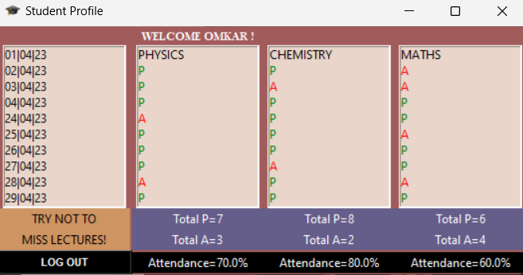
Student Profile
After logging in, the student can see his or her profile window.
The student profile window consists of attendance records of the student, marked as either P or A for that respective date for each of the 3 subjects Physics, Chemistry and Maths.
The overall attendance percentage as well as total number of times the student has attended lectures of a particular subject can also be seen.
Students cannot edit their own attendance records.

Slide 4
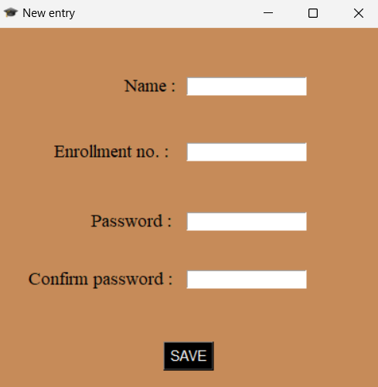
New Entry
If a student’s profile has not been created in the system, they can create a new entry as shown.
The new entry window accepts name, enrollment number and password from the student in order to create a new record.
After clicking save, the new entry along with that student’s details will automatically be created in the SQLite database.
Now this student’s attendance can be marked and viewed by the faculty member as well as student at will.

Slide 5
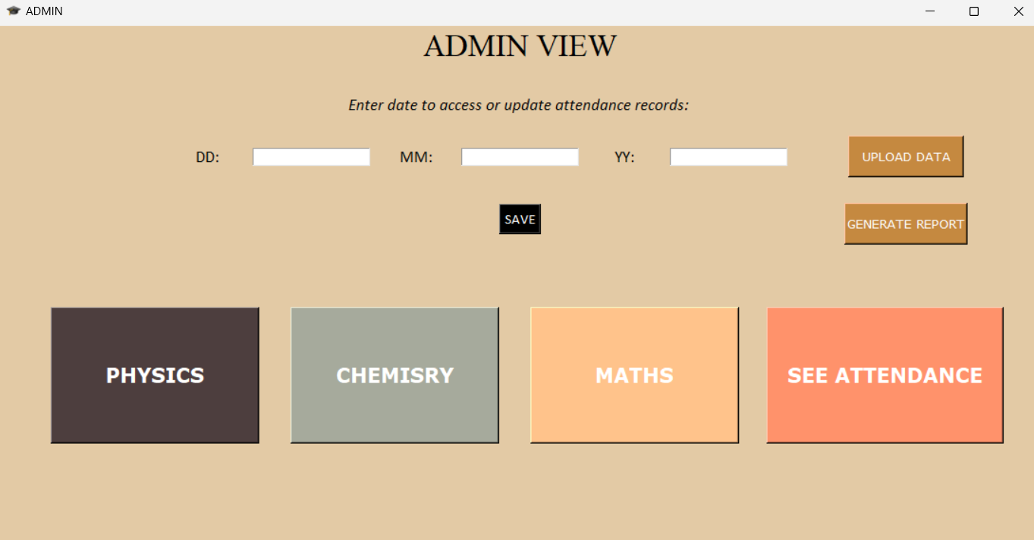
Faculty login
Once the faculty is logged in using password, they will be directed to the Admin Page.
The Admin view has the following functionality:
Enter attendance of Physics, Chemistry, Maths
See the attendance for the entire class
Upload data from a CSV file
Generate attendance report in PDF format
Note: The user of the system can configure
the names of the subjects according to the
needs

Slide 6
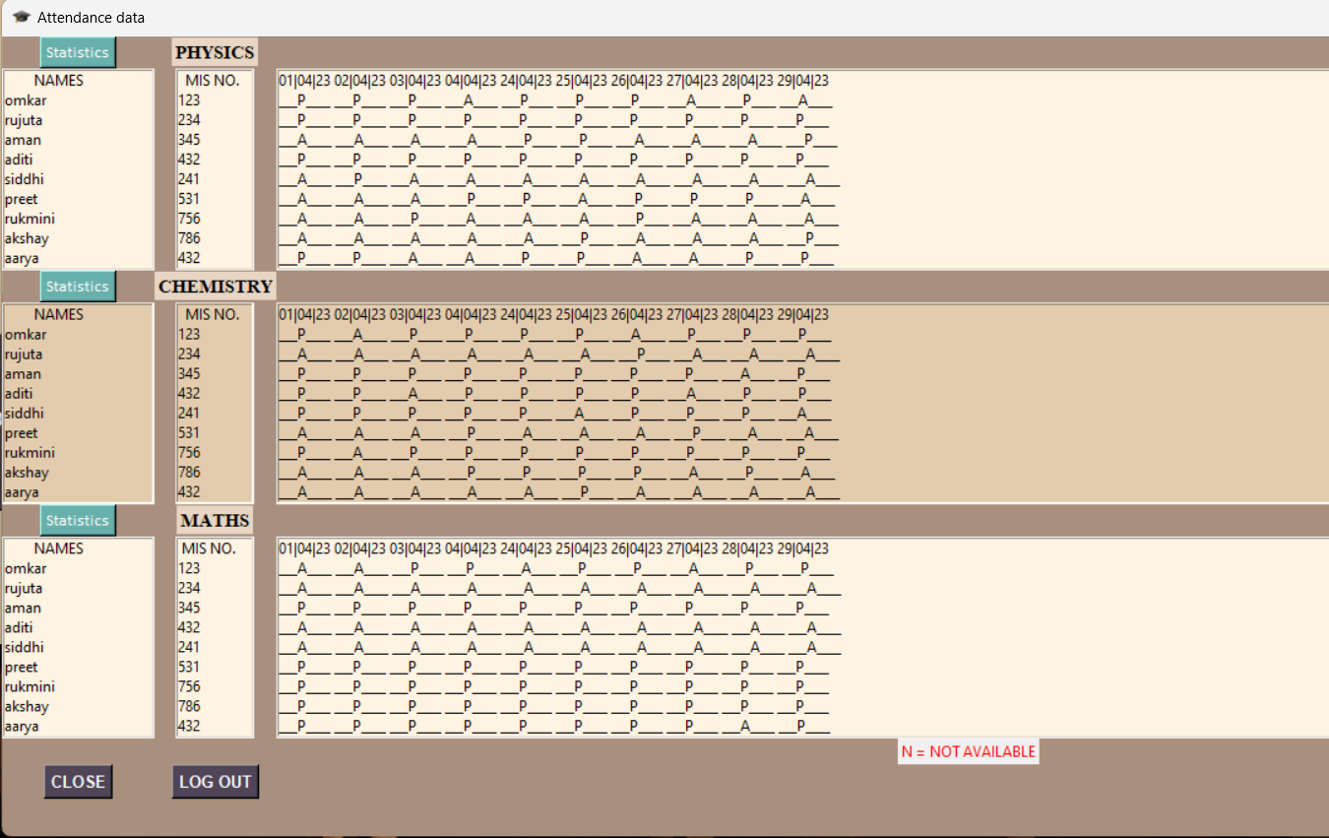
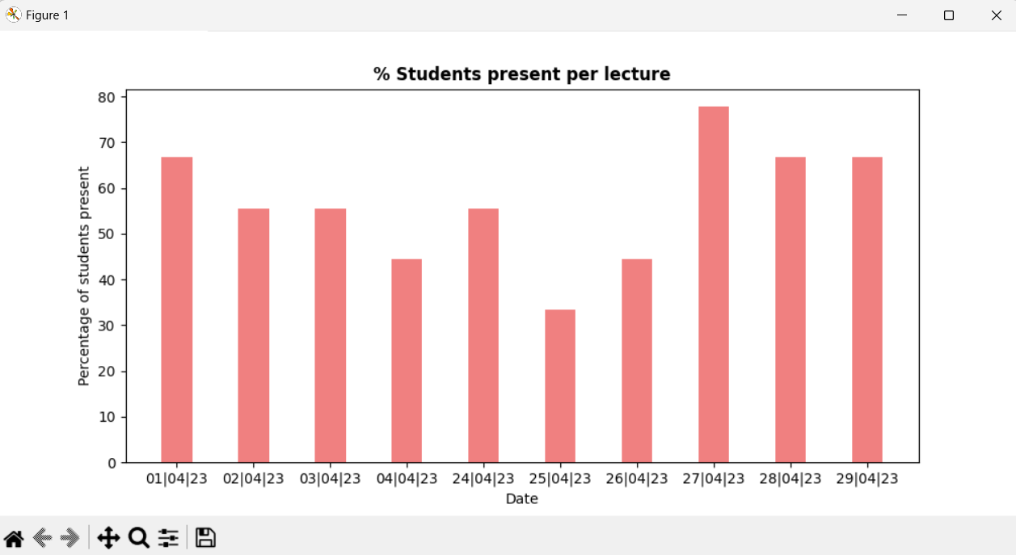
See Daily Attendance & Statistics
The faculty can view the Attendance of each student
They can also gets insights into the average daily class attendance for each subject separately using the statistics tab provided
This allows them to easily see, on which days the students are absent and can take appropriate decisions based on it

Slide 7

Upload Data from EXCEL & Generate PDF report
Uploading Data:
Signing up new students though the signup window can be a big task, especially if you have a large class
So, you can directly enter student data using the Upload Data button
You can import data from a CSV file or .xlsx file (EXCEL file)
Generating Reports:
You can generate a PDF report of each individual subject that will contain the attendance record of all students

Slide 8

THANK YOU
112103098 - Rukmini Nazre
112103099 - Omkar Oak

